Slide 1


PY-EXPO
2K24
Team ID: T004
Team Name: UCHIHAS
Genius innovation leaves behind a legacy...
PYEXPO 2K24

Slide 2




01
PYEXPO 2K24

Slide 3



Introduction
02
PYEXPO 2K24

Slide 4
The Indian Premier League (IPL) is a professional Twenty20 cricket league in India, renowned for its electrifying matches, star-studded teams, and global viewership. Launched in 2008, IPL has redefined cricket entertainment, blending athleticism, strategy, and spectacle. Its significance lies in revolutionizing the sport, attracting top talent worldwide, and serving as a lucrative platform for players and franchises alike.
03
PYEXPO 2K24

Slide 5
The problem statement involves leveraging machine learning to predict the winner of IPL 2024. By analyzing historical match data, player performance metrics, and team dynamics, the goal is to develop a predictive model that accurately forecasts the eventual champion, offering valuable insights to fans and stakeholders.
04
PYEXPO 2K24

Slide 6
PS Code: PY136
Problem Statement:
TITLE : IPL 2024 Winner Prediction
Desc : The challenge entails creating a predictive model that leverages machine learning techniques in Python to forecast the outcome of the IPL 2024 tournament. To achieve this, historical datasets comprising match results, player performances, team statistics, venue details, and other relevant information will be utilized. The aim is to build a robust prediction system that can analyze past trends, player form, team strategies, and various influencing factors to provide accurate predictions about the potential winner of the IPL 2024 season. This application will contribute to enhancing the excitement and engagement of cricket enthusiasts and stakeholders by offering insights into the probable outcomes of one of the most popular sporting events.
05
PYEXPO 2K24

Slide 7
Data
collection
Prediction
Generation
Solution
Data
Processing
Evaluation
And Validation
Training the
Model
Model
Selection
06
PYEXPO 2K24

Slide 8
Data
collection
Data Collection
Gathering the comprehensive historical data from past IPL seasons. And use the Python code to scrape data from a reliable source like ESPN Cricinfo:
Prediction
Generation
Solution
Data
Processing
Evaluation
And Validation
Training the
Model
Model
Selection
07
PYEXPO 2K24

Slide 9
Data Preprocessing
Clean and preprocess the collected data. Using pandas
Data
collection
Prediction
Generation
Data
Processing
Solution
Evaluation
And Validation
Training the
Model
Model
Selection
08
PYEXPO 2K24

Slide 10
Data
collection
Model Selection
Explore various machine learning algorithms suitable for the prediction task. But we are using logistics regreassion algorithms to set the models.
Prediction
Generation
Data
Processing
Evaluation
And Validation
Solution
Training the
Model
Model
Selection
09
PYEXPO 2K24

Slide 11
Training the Model
Split the preprocessed data into training and validation sets. Train the selected machine learning model on the training data, fine-tuning hyperparameters as necessary to optimize performance.
Data
collection
Prediction
Generation
Data
Processing
Evaluation
And Validation
Solution
Model
Selection
Training the
Model
10
PYEXPO 2K24

Slide 12
Evaluation and Validation
Evaluate the trained model's performance using the validation set and appropriate evaluation metrics, such as accuracy, precision, recall, or F1 score. Validate the model's predictions against actual IPL outcomes to assess its effectiveness and reliability.
Data
collection
Prediction
Generation
Data
Processing
Solution
Evaluation
And Validation
Training the
Model
Model
Selection
11
PYEXPO 2K24

Slide 13
Prediction Generation
Utilize the trained model to generate predictions for the IPL 2024 tournament winner based on input features such as player form, team strategies, historical trends, and other influencing factors.
Prediction
Generation
Data
collection
Solution
Data
Processing
Evaluation
And Validation
Training the
Model
Model
Selection
12
PYEXPO 2K24

Slide 14



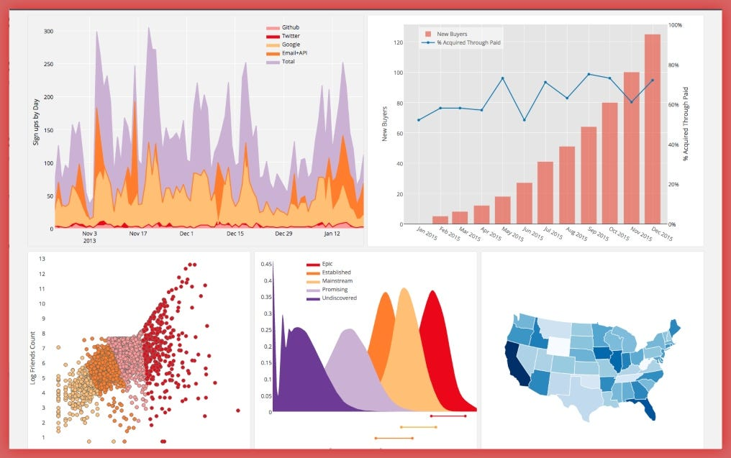
Technology Stack
Programming Language:
Python
Data Processing ,Analysis and visualization:
Pandas
NumPy
Matplotlib
13
PYEXPO 2K24

Slide 15




Machine Learning Libraries:
Scikit-learn
TensorFlow or PyTorch
Web Development:
Django-FRAMEWORK.
14
PYEXPO 2K24

Slide 16
Team Member Details:
MUSTAFA A (TL) 23AIA57
KARTHIK SARAN 23AIA47
ABISHEK S 23AIA03
PYEXPO 2K24

Slide 17

Thank You
Any Queries?
PYEXPO 2K24

